Slide 1
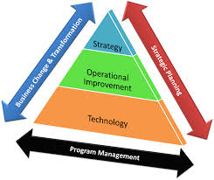
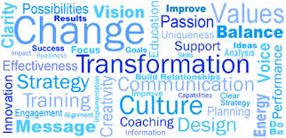
Data-Driven Transformation

Slide 2
Data-Driven Transformation
CALI 2015
Phil Bohl, Assistant Dean Mike Vogt, Mgr Instructional Tech Pepperdine Law Pepperdine Law
pbohl@pepperdine.edu mvogt2@pepperdine.edu

Slide 3
What have you walked into?
Assessment in a Law School Context & ABA Standards
The Why’s of Adopting Assessment Methodologies
Using Tech for Assessment
Feedback

Slide 4
Notice
The opinions expressed in this presentation are not the opinions of the management of Pepperdine School of Law nor should Pepperdine be held liable for the content expressed here in.
No endangered species were consulted or injured in the preparation of this material.

Slide 5
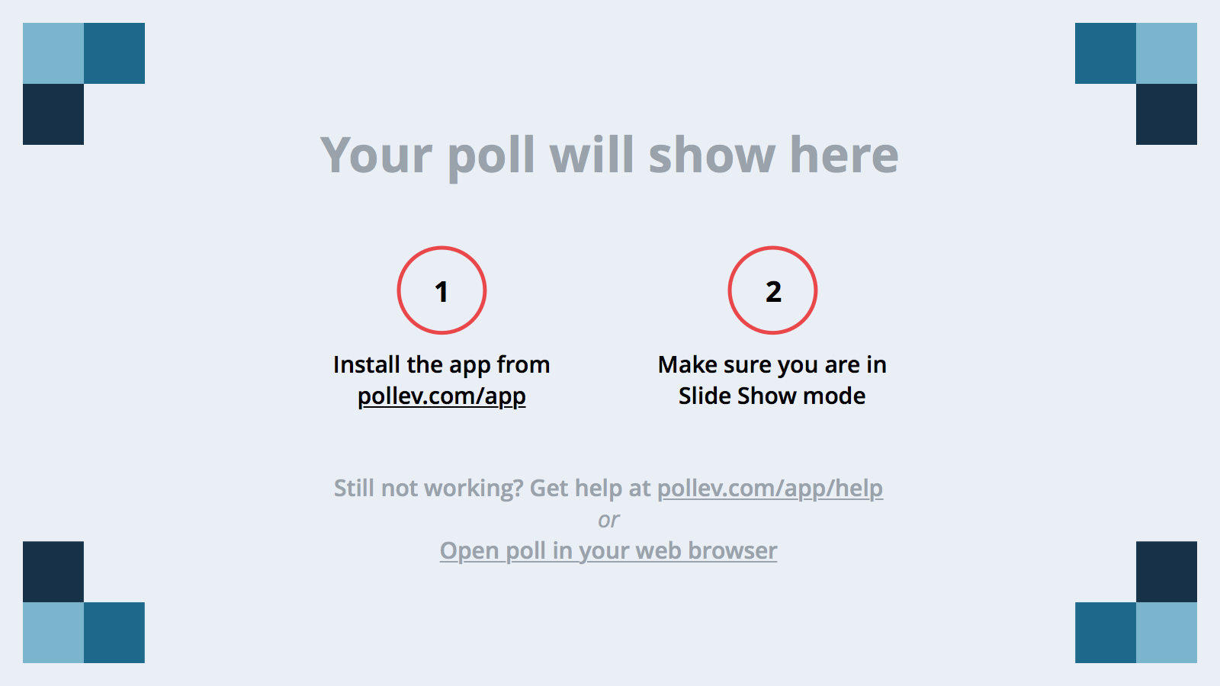
Notes:
Poll Title: What is your confidence level for your understanding of "Assessment"? https://www.polleverywhere.com/multiple_choice_polls/xrQ60DTwjLhPqba

Slide 6
What is Assessment?
What is the Purpose of Assessment?
Why Should We Care?

Slide 7
Definition
Grading - Evaluate individual student learning and performance
Assessment – Collect and use data to improve student learning
Accreditation is a secondary objective

Slide 8
What is the Purpose?
Collect data to help inform enhancement and remove any bottlenecks
Reflection promotes critical thinking by promoting deep learning
Increase knowledge and skills acquisition and retention
Improves comprehension and motivation

Slide 9
Why We Should Care - ABA Standards
No longer optional, but make no mistake, we still have to sell it
Standard 314 – Assessing Student Learning
Standard 315 – Program Level Assessment

Slide 10
How does it work?
Asks Questions…
What do we want our students to be able to do when they graduate?
How well do we want them to be able to do it?
How do we know if we are doing what we think we are?
Are we performing at the best possible level?

Slide 11
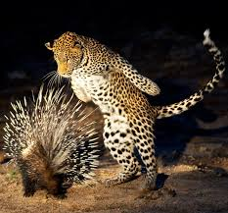
Challenges to Assessment
Large change, added burdens can become overwhelming
Ostrich Effect
Fear of criticism
Porcupine Response

Slide 12
Additional Challenges
Lack of relevance – How does it help? Why would we need it?
Academic vs. practical skills
Students are a product of a different educational process

Slide 13
Program Level Assessment
Program Objectives
Direct Measures
Indirect Measures
Findings
Actions

Slide 14
Review Process
Impetus for Review
Comparison between desired and current state
Findings
Decisions and Actions
Plan and Structure to Assess Revision
Buy-in for change
Identifying Desired State
Tools include: Mastery Grid and Outcomes Matrix
– Carnegie Mellon

Slide 15
Individual Assessments
Diagnostic – Current conceptions prior to learning process
Formative – Monitor student understanding during the process
Summative – Evaluate learning at the end of a process

Slide 16
Formative vs. Summative Assessment
Formative: Regular assessment that monitors student learning progress during the learning process and is typically low-value
Summative: Evaluates student learning product at the end of learning process and is typically high-value

Slide 17
Summative Assessment Model
Instructor Pace
Student Learning Pace
Final Exam

Slide 18
Formative and Summative
Continuous feedback throughout learning process
Instructor Pace
Student Pace

Slide 19
Summative Assessments
Final Exams
Midterms
Final Projects
Final Paper
High value and no opportunity for improvement

Slide 20
Examples of Formative Assessments
Begin to think less linear and more conceptually
“You teach yourselves the law, but I train your minds. You come in here with a skull full of mush; you leave thinking like a lawyer.” - Charles Kingsfield Jr.
Alignment - Carefully consider what is your objective and then determine what assessments will best measure progress

Slide 21
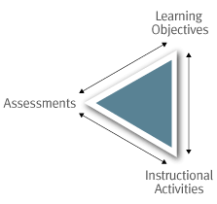
Carnegie Mellon Eberly Center for Teaching Excellence & Educational Innovation
Learning Objectives
Assessments
Instructional Strategies

Slide 22
Formative Assessments
Feedback is the central function of formative assessment.
Allows students to restructure and improve their learning by identifying strengths and weaknesses and areas for improvement
Help faculty recognize where students are struggling and address problems quickly
Low value and offer feedback while there is still an opportunity for enhancement
Assess process, not just product

Slide 23
Examples of Assessments
Concept Maps or Quizzes
Clicker polling
Peer-to-Peer Assessment
Group Work
Students begin to look for feedback opportunities

Slide 24
Additional Examples
CAT’s – Muddiest point, 1 minute essays, main point, directed paraphrasing, hypos, application cards, summaries, etc.
Online quizzing
Examsoft Rubrics – Each assessment measure is tied to a learning outcome objective
Individual Assessment Rubrics – Share rubrics with students in advance of assessment

Slide 25
Establishing Faculty Buy-in
Faculty Advisory Council
Keep it relevant
Keep it simple
Make faculty stakeholders – They determine how they will use gathered data

Slide 26
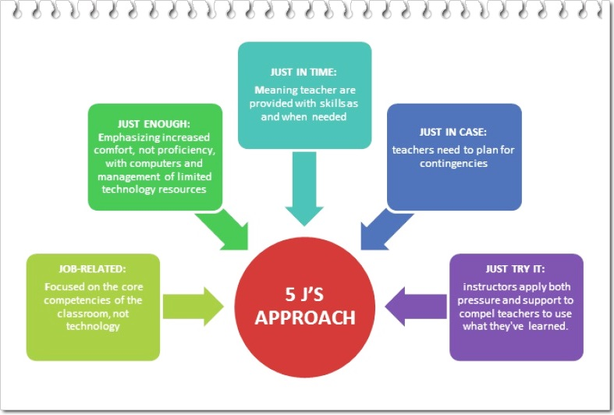
Continued…
5 J’s Approach
High degree of support
Not coerced compliance
Ownership in the process
Feedback offers opportunities
for enhancement

Slide 27
Recap: Benefits of Assessment
Reveals blind spots and surprises
Removes needless barriers to excellence
Provide Opportunities for Enhancement
Increase student motivation, comprehension, and engagement

Slide 28
Twitter Thread
#CALIassessment15
1. Post what your school is doing to address Standard 314
2. What are obstacles you have encountered?
3. What are solutions you have developed?

Slide 29
Questions?
Phil
pbohl@pepperdine.edu
Mike
mvogt2@pepperdine.edu

